Slide 1

SavePaws Club – Animal Rescue & Welfare Platform
A Web-Based Solution to Reduce Pet Harassment, Pain & Poverty
Will Be Developed By -
4 Bytes
Presented to Sadia Jahan,
Assistant Professor, Department of CSE, UITS

Slide 2




Our Team:
Helal Uddin Patwary
ID-0432410005101086
Role: Database , UI/UX & Research
Joy Goswami Niloy
ID-0432410005101069
Role: Full Stack Developer
Shalehin Ahmed Ornob
ID-0432410005101083
Role: Backend & Database
Shamiur Hasan
ID-0432410005101053
Role: Front End Developer

Slide 3
The Unspoken Crisis: Our Motivation
Every day, countless stray and domestic animals endure injury, abuse, and neglect. This suffering often goes unnoticed or unaddressed due to a critical lack of public awareness and immediate response tools. Help is frequently delayed, leading to prolonged pain and preventable loss of life.
Our vision is to create a centralized, responsive web solution that empowers individuals to act immediately and responsibly, protecting animals in need. We aim to educate, connect, and empower a caring community of animal lovers.

Slide 4
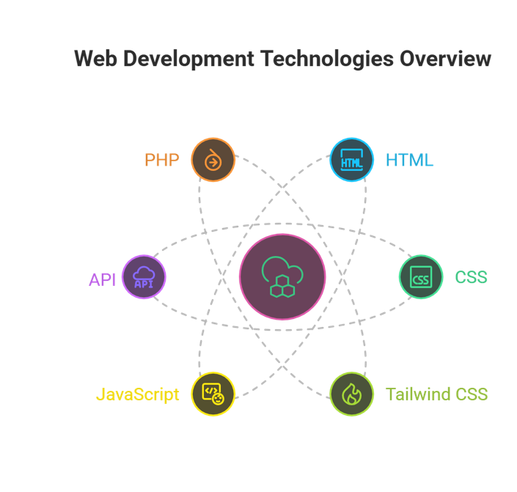
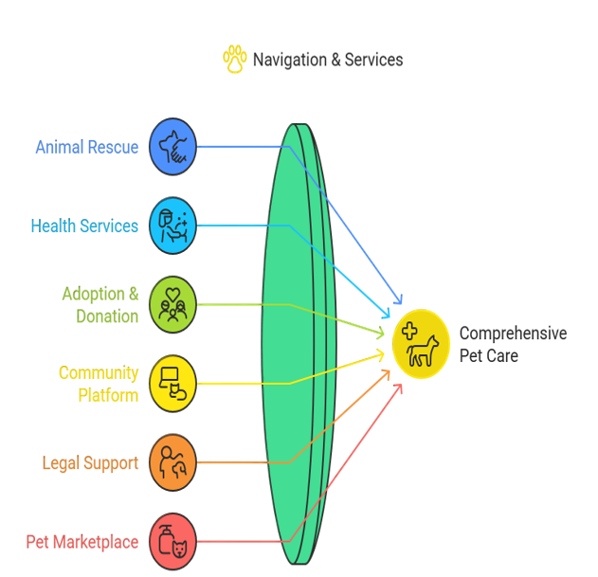
Navigation & Services
Technologies Overview

Slide 5
Immediate Impact: The Emergency Rescue System
Online Actions
Offline Solutions
Share precise location to dispatch the nearest rescue team.
Web app users can access saved emergency contacts and first-aid guidance even without internet.
Click-to-call verified help centers, ensuring immediate connection.
One-time login with a phone number triggers automatic SMS with crucial rescue and emergency contacts, ensuring help in low or no-network zones.
This dual online and offline approach ensures that help is always within reach, bridging the gap for vulnerable animals in critical moments.

Slide 6
Compassionate Care: Treatment & Legal Support
Treatment Services
Legal Help
Initial medicine suggestions for common symptoms (with a clear disclaimer).
Instant reporting of animal cruelty directly through the platform.
Recommendations for nearby veterinary clinics and trusted doctors, complete with contact details.
Direct contacts for nearest police stations and law enforcement agencies.
Essential emergency health care tips and step-by-step first-aid guidance.
Comprehensive legal information section detailing animal protection laws in your region.
These features empower users to provide immediate medical attention and hold abusers accountable, fostering a safer environment for animals.

Slide 7



Building a Community of Care
Adoption System
Community Forum
Donation Portal
Connects loving homes with verified pets needing adoption. Users can responsibly adopt or list pets for donation.
A vibrant social space for animal lovers to share experiences, form local rescue groups, organize aid, and collectively educate each other.
Facilitates transparent donations to reliable NGOs, with full contact and operational details provided for peace of mind.

Slide 8
Why SavePaws Club is a Game Changer
Real-World Impact
Cutting-Edge Technology
Holistic Solution
Designed for immediate, tangible change in animal welfare, with features that scale to meet growing needs.
Utilizes the latest web technologies to provide a sophisticated and user-friendly platform for a crucial social cause.
Uniquely combines emergency response technology, e-commerce, educational resources, and a supportive community hub.

Slide 9

The Journey Ahead: Milestones & Growth
Our roadmap includes expanding our network of verified rescue partners, enhancing AI-driven symptom analysis, integrating more legal aid resources, and launching localized campaigns. We aim to be the leading global platform for animal welfare, continuously innovating to meet the diverse needs of animals and their human allies.

Slide 10
Thank you For Your Time & Attention
Let’s help every voice be
heard — even those who
cannot speak.

